Slide 1

Nightly Price Prediction on Chicago Listings Data
Craig Bentzen
October 2020

Slide 2
Problem Statement
Setting up an Airbnb is a financially daunting and time consuming task. As an Airbnb host myself, I had to try to figure out what guests were looking in an effort to price my listing correctly.
Airbnb provides a price estimator tool but I found the results to be poor. I was consistently renting my listing for $125 a night, while the price estimator tool suggested $60.
It was also difficult to determine which listing features mattered most to guests. I want to use machine learning techniques to try and answer the below questions:
Can I build a price prediction model?
What features of an Airbnb listing continue most to price?

Slide 3
The Source Data
Source - InsideAirbnb.com - Publically available data gather in June 2019 for Chicago
Why Chicago? - I live in Chicago.
Initial shape - 8,519 records (one record per listing) and 72 features
Data Wrangling:
Reviewed high and low outliers - removed when warranted
Null strings set to ‘none’
Null numerical values set to ‘0’
Thirty-two features were dropped because they were unhelpful for analysis

Slide 4
Feature Creation
The following features were created to help with the modeling and data analysis:
Average Neighborhood Price divided by the Average Neighborhood Accommodations
Average Price for each Neighborhood
Average Price by number of bedrooms and bathrooms for each Neighborhood
Average Price by property type for each Neighborhood
Average Price by number of reviews for each Neighborhood
Word count of Amenities
Word count of Listing Description
Word count of Host about
Word count of House Rules

Slide 5
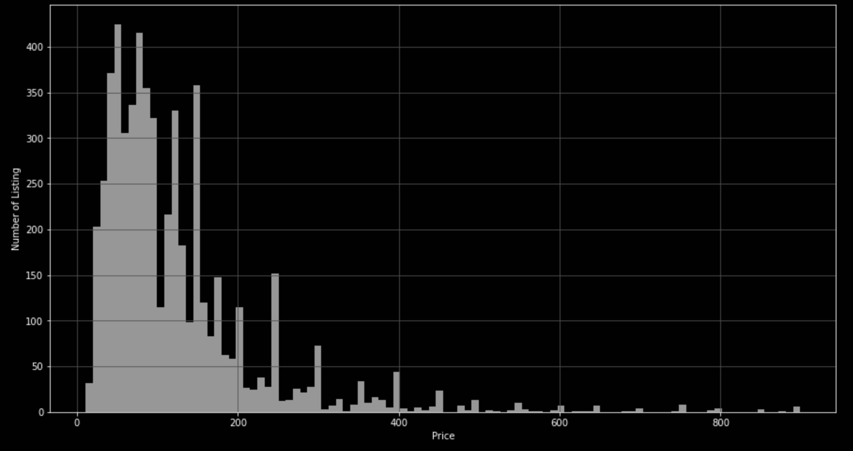
Exploratory Data Analysis
Distribution of Price

Slide 6
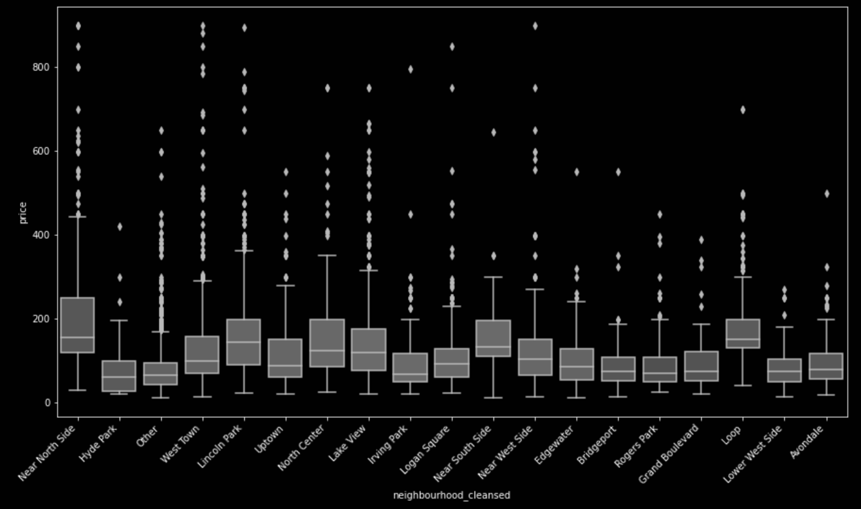
Exploratory Data Analysis
Box plots of Nightly price by Neighborhood. Many outliers - But should they be removed?

Slide 7
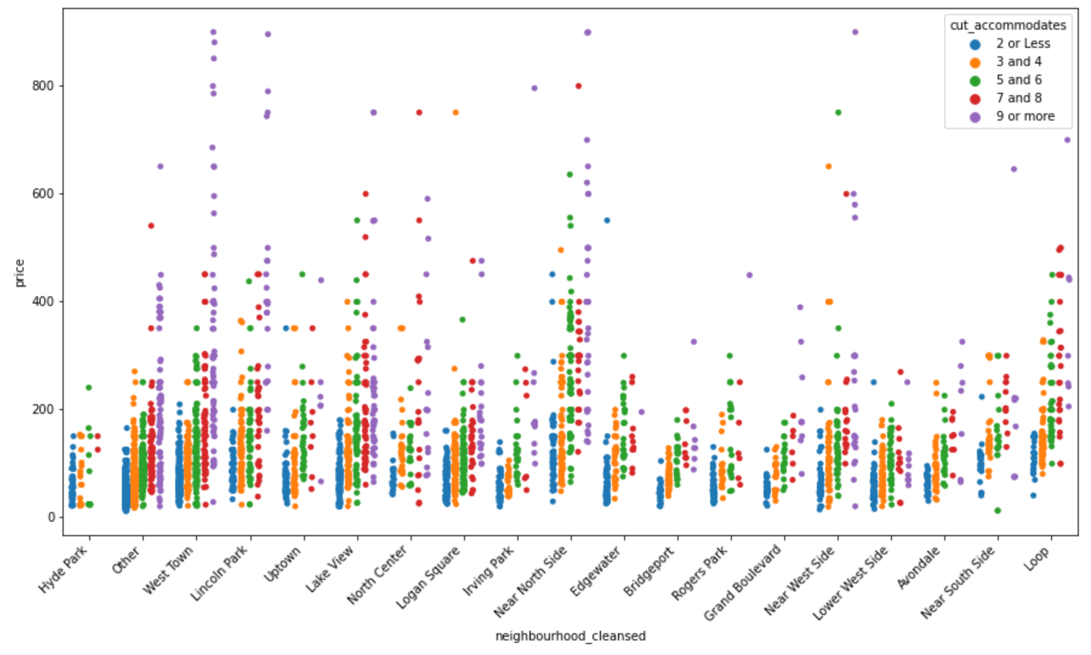
Exploratory Data Analysis
The higher priced listing accommodate more people.

Slide 8
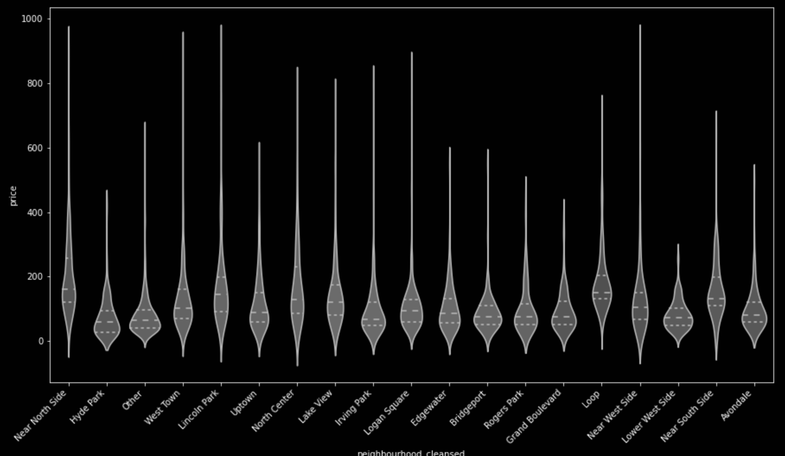
Exploratory Data Analysis
Violin Plot of Nightly Price by Neighborhood to show that more expensive touristy neighborhoods have a greater range of distribution.

Slide 9
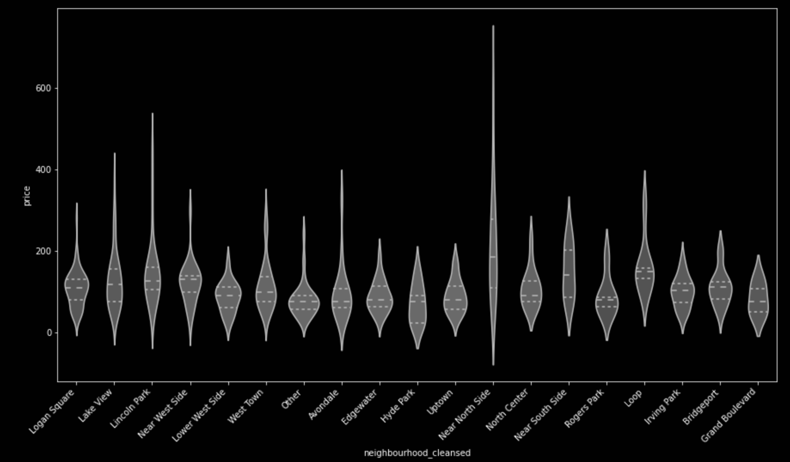
Exploratory Data Analysis
Violin Plot of Nightly Price by Neighborhood for highest performing listings. Listings with more than 3.2 ratings per month and 98% rating value. Top 25% in each category.

Slide 10
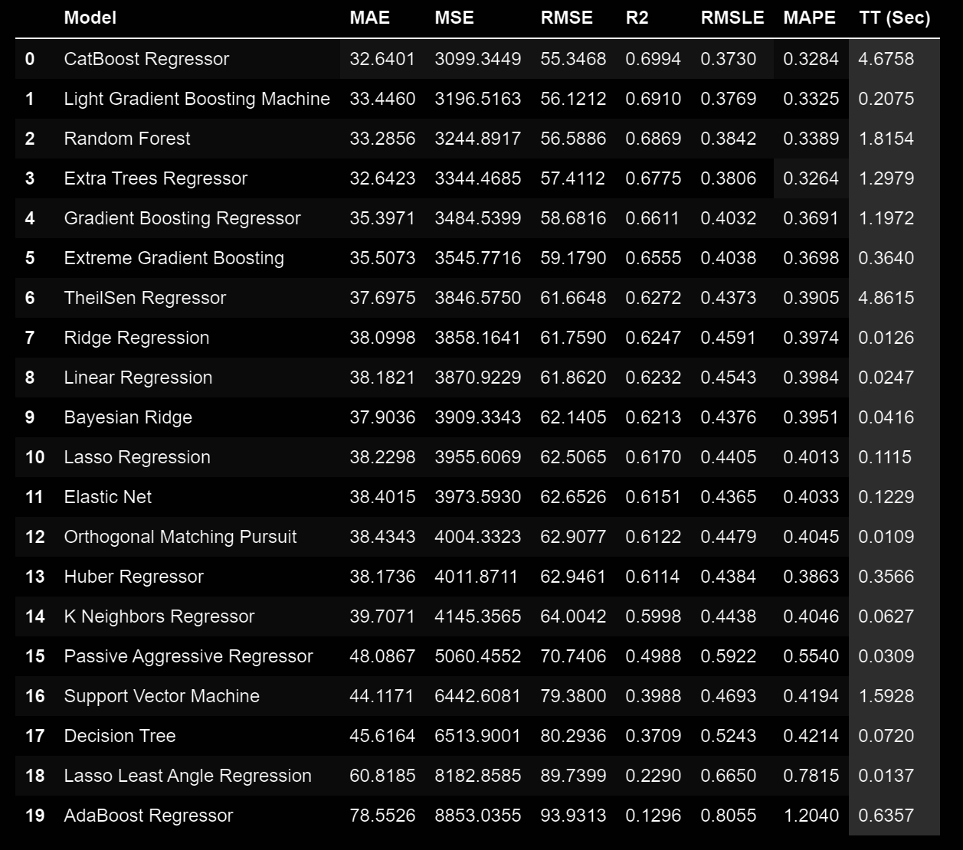
Data Modeling - Initial Findings
MAPE - 32% error on average for each prediction
RMSE - Standard deviation of $55
Tree based models perform better

Slide 11
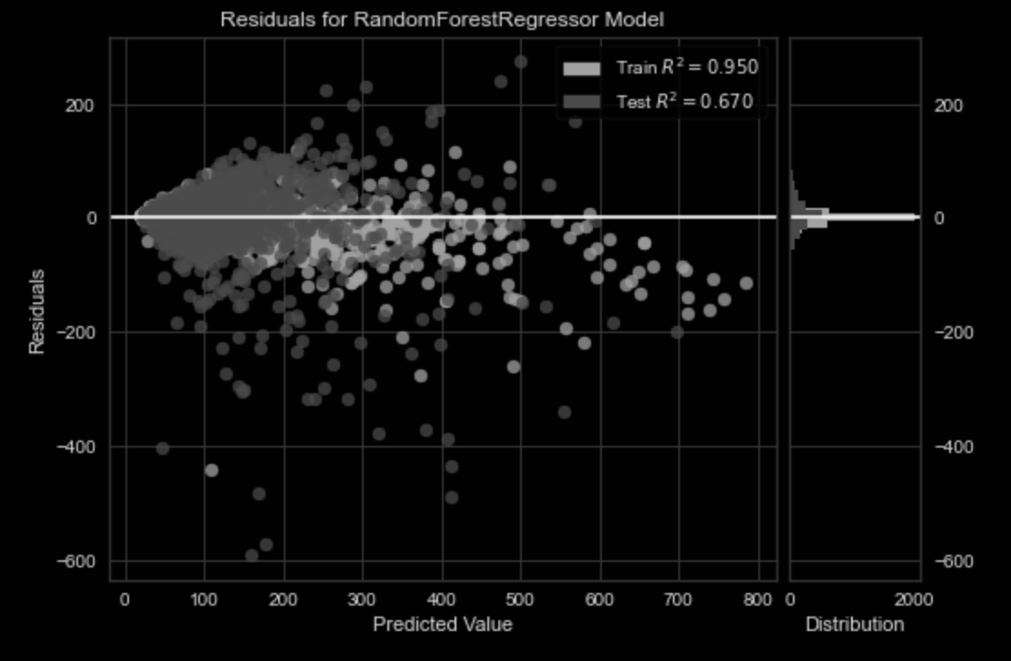
Data Modeling - Initial Findings
Residual plot of Random Forest Regressor Model
Overfitting Issue - Train R2 is significantly greater with than test R2
Residuals don’t look uniform at higher predicted values
Overfitting reduction techniques had little affect

Slide 12
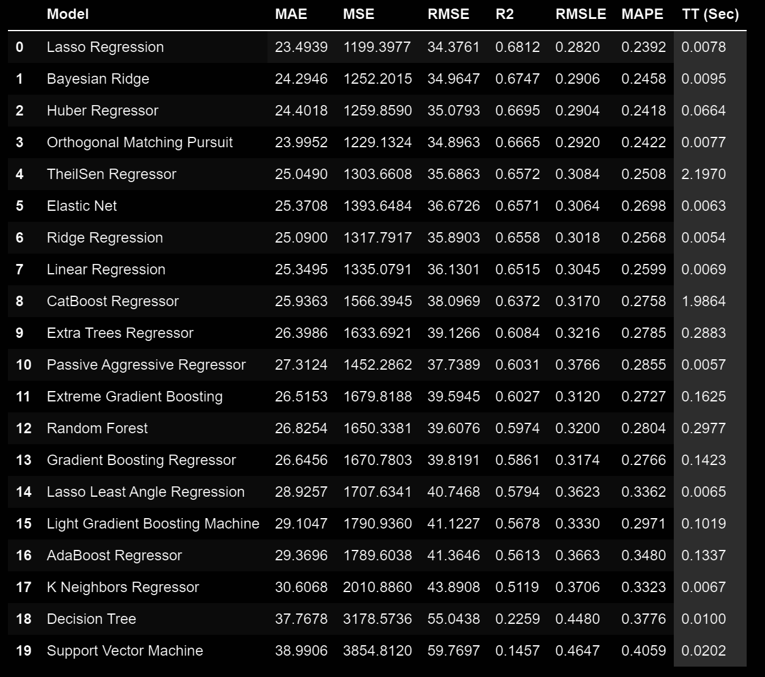
Data Modeling - High Performing Airbnbs
There are many Airbnb’s that have very few reviews and low ratings
Does it make more sense to only use successful Airbnb’s in a price prediction model?
Reduced data set to listings with 3.2 ratings per month and a review rating of 98 or larger - top 25% in each category
MAPE - 23% error in predicted
RMSE - Standard deviation of $34
Linear regression models outperform decision trees

Slide 13
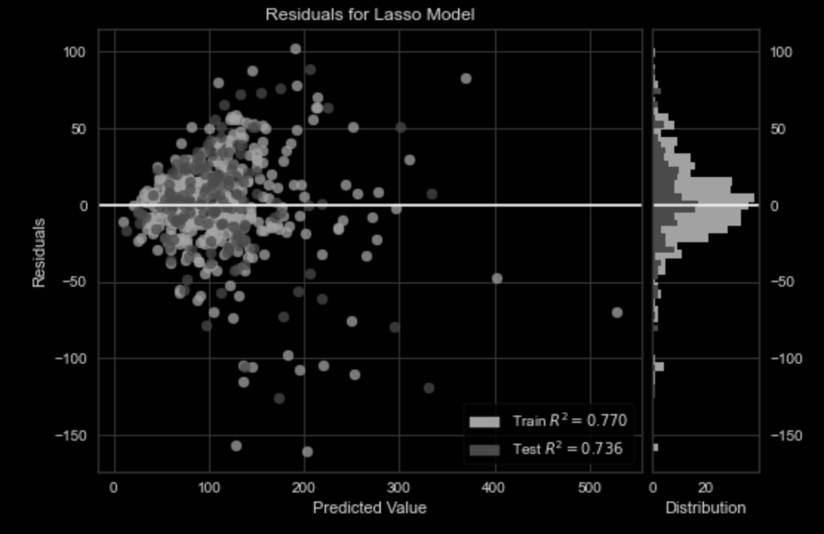
Data Modeling - High Performing Airbnbs
Residual plot for LASSO regression
Overfitting isn’t an issue
Distribution of residuals is even.

Slide 14
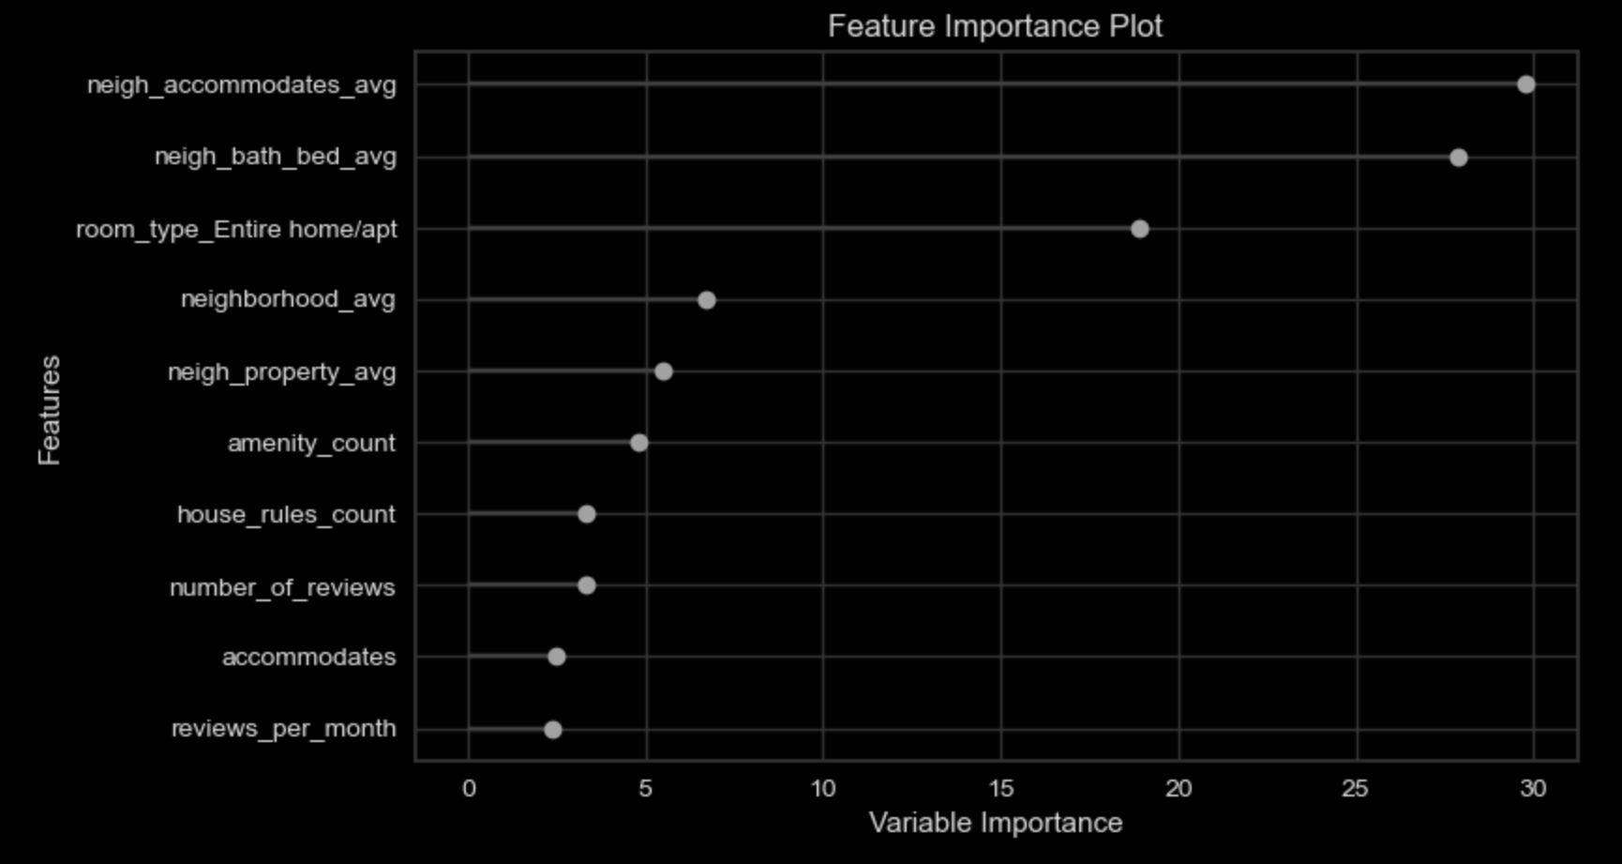
Data Modeling - High Performing Airbnbs

Slide 15
Conclusions
Including only high performing Airbnbs, a better model can be created. This is most likely due to the fact that guests understand value and provide a confirmation of value with bookings and positive ratings.
With a RMSE of $34 the LASSO Regression model is the best model for high performing Airbnbs. The data has many outliers and RMSE penalizes data with outliers. Minimizing the RMSE is the best way to evaluate the models. The test R2 value of .68 is okay - which means 68% of price’s variability can be explained by the model’s features.
Looking back on my own experience setting up an Airbnb - I wish the price predictor tool available to me was only $34 dollars off.
The features that contributed most to price were the neighborhood, accommodates, room type, amenities count, number of reviews, and house rules.

Slide 16
Future Research
Examining the records that caused the most error
Using computer vision techniques on the listings photographs
Natural Language processing on Description, Title, About, and Reviews -- Looking for important phrases of the most successful Airbnbs

